Slide 1
SPECIAL ORGANS.

Slide 2
The Eye
The eye is a special organ used for vision. Visual perception is the ability to interpret the surrounding environment using light in the visible spectrum reflected by the objects in the environment.
The various physiological components involved in vision are referred to collectively as the visual system.
There are three layers of tissue in the walls of the eye: • the outer fibrous layer: sclera and cornea • the middle vascular layer or uveal tract: consisting of the choroid, ciliary body and iris • the inner nervous tissue layer: the retina.

Slide 3
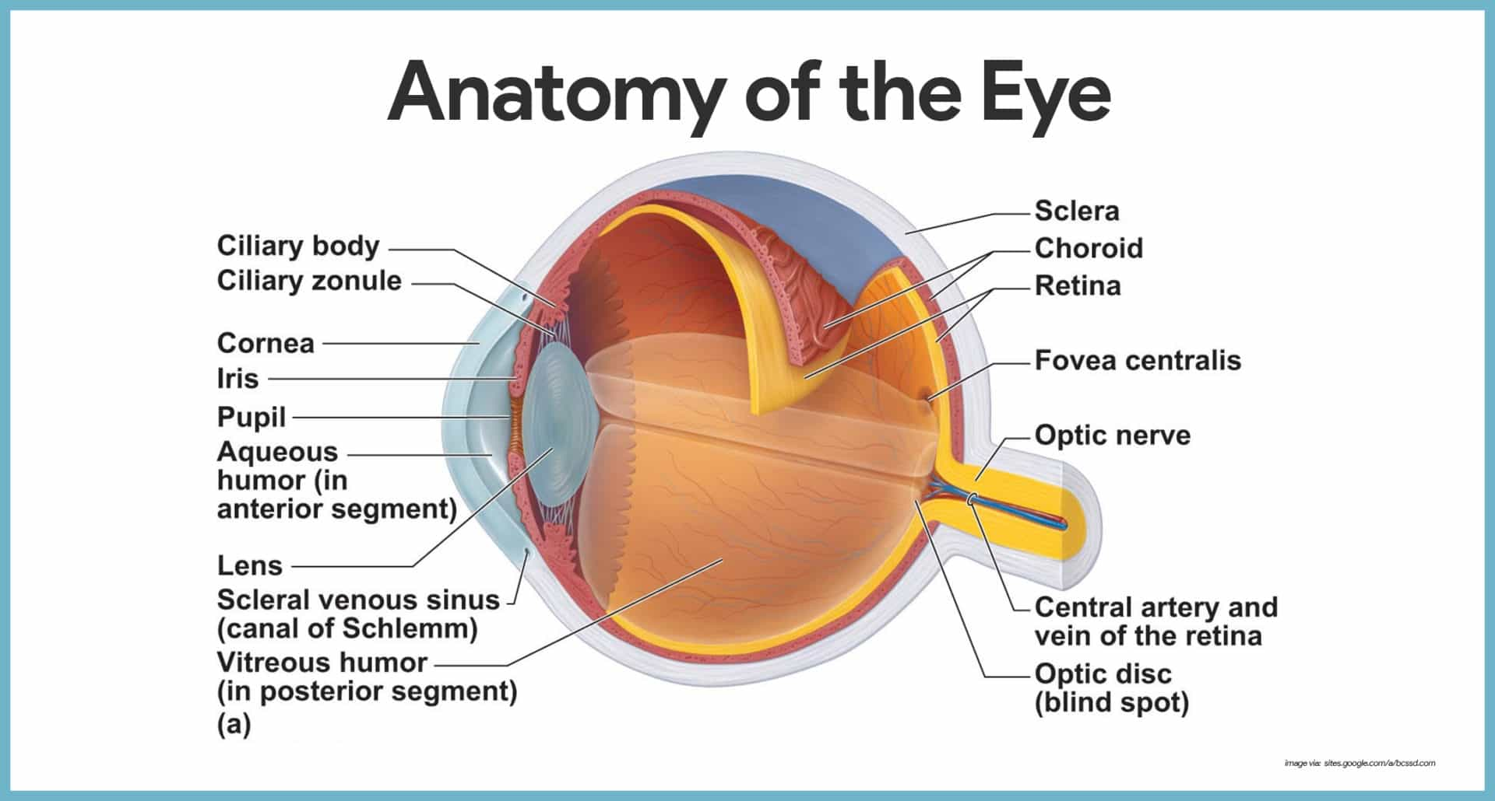

Slide 4
The eyes sit in the orbits of the skull, protected by bone and fat.
The white part of the eye is the sclera. It protects interior structures and surrounds a circular portal formed by the cornea, iris, and pupil.
The cornea is transparent to allow light to enter the eye, and curved to direct it through the pupil behind it. The cornea is convex anteriorly and is involved in refracting (bending) light rays to focus them on the retina.
The pupil is actually an opening in the colored disk of the iris.
The iris dilates or constricts, adjusting how much light passes through the pupil and onto the lens. The color of the iris is genetically determined and depends on the number of pigment cells present. Albinos have no pigment cells and people with blue eyes have fewer than those with brown eyes
The curved lens then focuses the image onto the retina, the eye’s interior layer.
The retina is a delicate membrane of nervous tissue containing photoreceptor cells. These cells, the rods and cones, translate light into nervous signals. The optic nerve carries the signals from the eye to the brain, which interprets them to form visual images.

Slide 5
Rods are more sensitive to light that cones and leads to monochromic vision- black and white.
Visual purple (rhodopsin) is a light-sensitive pigment present only in the rods. It is bleached (degraded) by bright light and is quickly regenerated, provided an adequate supply of vitamin A is available.
The cones are sensitive to light and colour; bright light is required to activate them and give sharp, clear colour vision. The different wavelengths of visible light sensitive pigments in the cones, resulting in the perception of different colours.

Slide 6
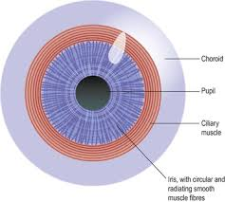

Slide 7
External and Accesory structures
Eyelids. Anteriorly, the eyes are protected by the eyelids, which meet at the medial and lateral corners of the eye, the medial and lateral commissure (canthus), respectively.
Eyelashes. Projecting from the border of each eyelid are the eyelashes.
Tarsal glands. Modified sebaceous glands associated with the eyelid edges are the tarsal glands; these glands produce an oily secretion that lubricates the eye; ciliary glands, modified sweat glands, lie between the eyelashes.
Conjunctiva. A delicate membrane, the conjunctiva, lines the eyelids and covers part of the outer surface of the eyeball; it ends at the edge of the cornea by fusing with the corneal epithelium.

Slide 8
Lacrimal apparatus. The lacrimal apparatus consists of the lacrimal gland and a number of ducts that drain the lacrimal secretions into the nasal cavity.
Lacrimal glands. The lacrimal glands are located above the lateral end of each eye; they continually release a salt solution (tears) onto the anterior surface of the eyeball through several small ducts.
Lacrimal canaliculi. The tears flush across the eyeball into the lacrimal canaliculi medially, then into the lacrimal sac, and finally into the nasolacrimal duct, which empties into the nasal cavity.

Slide 9
Lysozyme. Lacrimal secretion also contains antibodies and lysozyme, an enzyme that destroys bacteria; thus, it cleanses and protects the eye surface as it moistens and lubricates it.
Extrinsic eye muscle. Six extrinsic, or external, eye muscles are attached to the outer surface of the eye; these muscles produce gross eye movements and make it possible for the eyes to follow a moving object; these are the lateral rectus, medial rectus, superior rectus, inferior rectus, inferior oblique, and superior oblique.

Slide 10
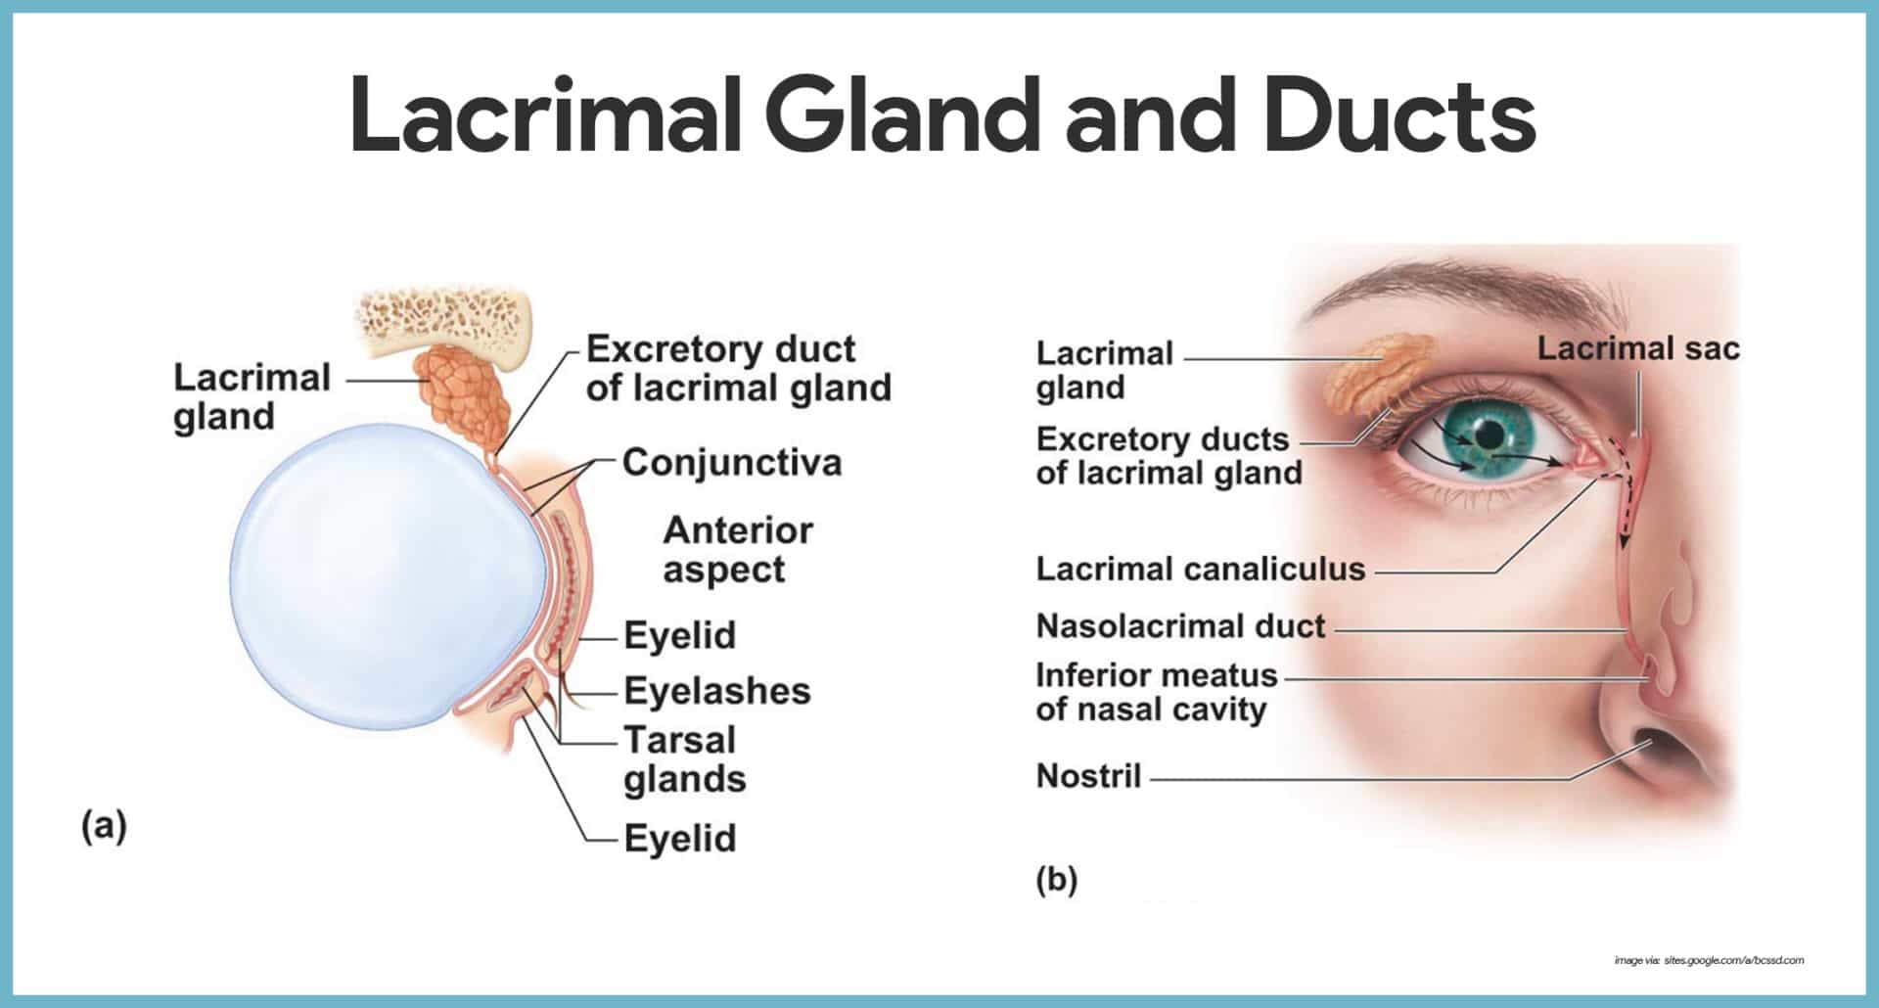

Slide 11
Internal Structures: The Eyeball
The eye itself, commonly called the eyeball, is a hollow sphere; its wall is composed of three layers, and its interior is filled with fluids called humors that help to maintain its shape.
Layers forming the eye ball
Fibrous layer. The outermost layer, called the fibrous layer, consists of the protective sclera and the transparent cornea.
Sclera. The sclera, thick, glistening, white connective tissue, is seen anteriorly as the “white of the eye”.
Cornea. The central anterior portion of the fibrous layer is crystal clear; this “window” is the cornea through which light enters the eye.

Slide 12
Vascular layer. The middle eyeball of the layer, the vascular layer, has three distinguishable regions: the choroid, the ciliary body, and the iris.
Choroid. Most posterior is the choroid, a blood-rich nutritive tunic that contains a dark pigment; the pigment prevents light from scattering inside the eye. It is deep chocolate brown in colour.
Ciliary body. Moving anteriorly, the choroid is modified to form two smooth muscle structures, the ciliary body, to which the lens is attached by a suspensory ligament called ciliary zonule- this controls size and thickness of the lens.
Pupil. The pigmented iris has a rounded opening, the pupil, through which light passes

Slide 13
Sensory layer. The innermost sensory layer of the eye is the delicate two-layered retina, which extends anteriorly only to the ciliary body.
Pigmented layer. The outer pigmented layer of the retina is composed pigmented cells that, like those of the choroid, absorb light and prevent light from scattering inside the eye.
Neural layer. The transparent inner neural layer of the retina contains millions of receptor cells, the rods and cones, which are called photoreceptors because they respond to light.

Slide 14
Two-neuron chain. Electrical signals pass from the photoreceptors via a two-neuron chain-bipolar cells and then ganglion cells– before leaving the retina via optic nerve as nerve impulses that are transmitted to the optic cortex; the result is vision.
Optic disc. The photoreceptor cells are distributed over the entire retina, except where the optic nerve leaves the eyeball; this site is called the optic disc, or blind spot.
Fovea centralis. Lateral to each blind spot is the fovea centralis, a tiny pit that contains only cones.

Slide 15
The Lens
Light entering the eye is focused on the retina by the lens, a flexible biconvex, crystal-like structure.
Chambers. The lens divides the eye into two segments or chambers; the anterior (aqueous) segment, anterior to the lens, contains a clear, watery fluid called aqueous humor; the posterior (vitreous) segment posterior to the lens, is filled with a gel-like substance called either vitreous humor, or the vitreous body.
Vitreous humor. Vitreous humor helps prevent the eyeball from collapsing inward by reinforcing it internally.

Slide 16
Aqueous humor. Aqueous humor is similar to blood plasma and is continually secreted by a special of the choroid; it helps maintain intraocular pressure, or the pressure inside the eye.
Canal of Schlemm. Aqueous humor is reabsorbed into the venous blood through the scleral venous sinus, or canal of Schlemm, which is located at the junction of the sclera and cornea.

Slide 17
Eye Reflexes
Both the external and internal eye muscles are necessary for proper eye function.
Photopupillary reflex. When the eyes are suddenly exposed to bright light, the pupils immediately constrict; this is the photopupillary reflex; this protective reflex prevents excessively bright light from damaging the delicate photoreceptors.
Accommodation pupillary reflex. The pupils also constrict reflexively when we view close objects; this accommodation pupillary reflex provides for more acute vision.

Slide 18
Vision perception
Light passes through the front of the eye (cornea) to the lens.
The cornea and the lens help to focus the light rays onto the back of the eye (retina).
The cells in the retina absorb and convert the light to electrochemical impulses which are transferred along the optic nerve and then to the brain.

Slide 19
The Ear
The ear is an organ used for hearing and balance.
Anatomy of the Ear
Anatomically, the ear is divided into three major areas: the external, or outer, ear; the middle ear, and the internal, or inner, ear.

Slide 20
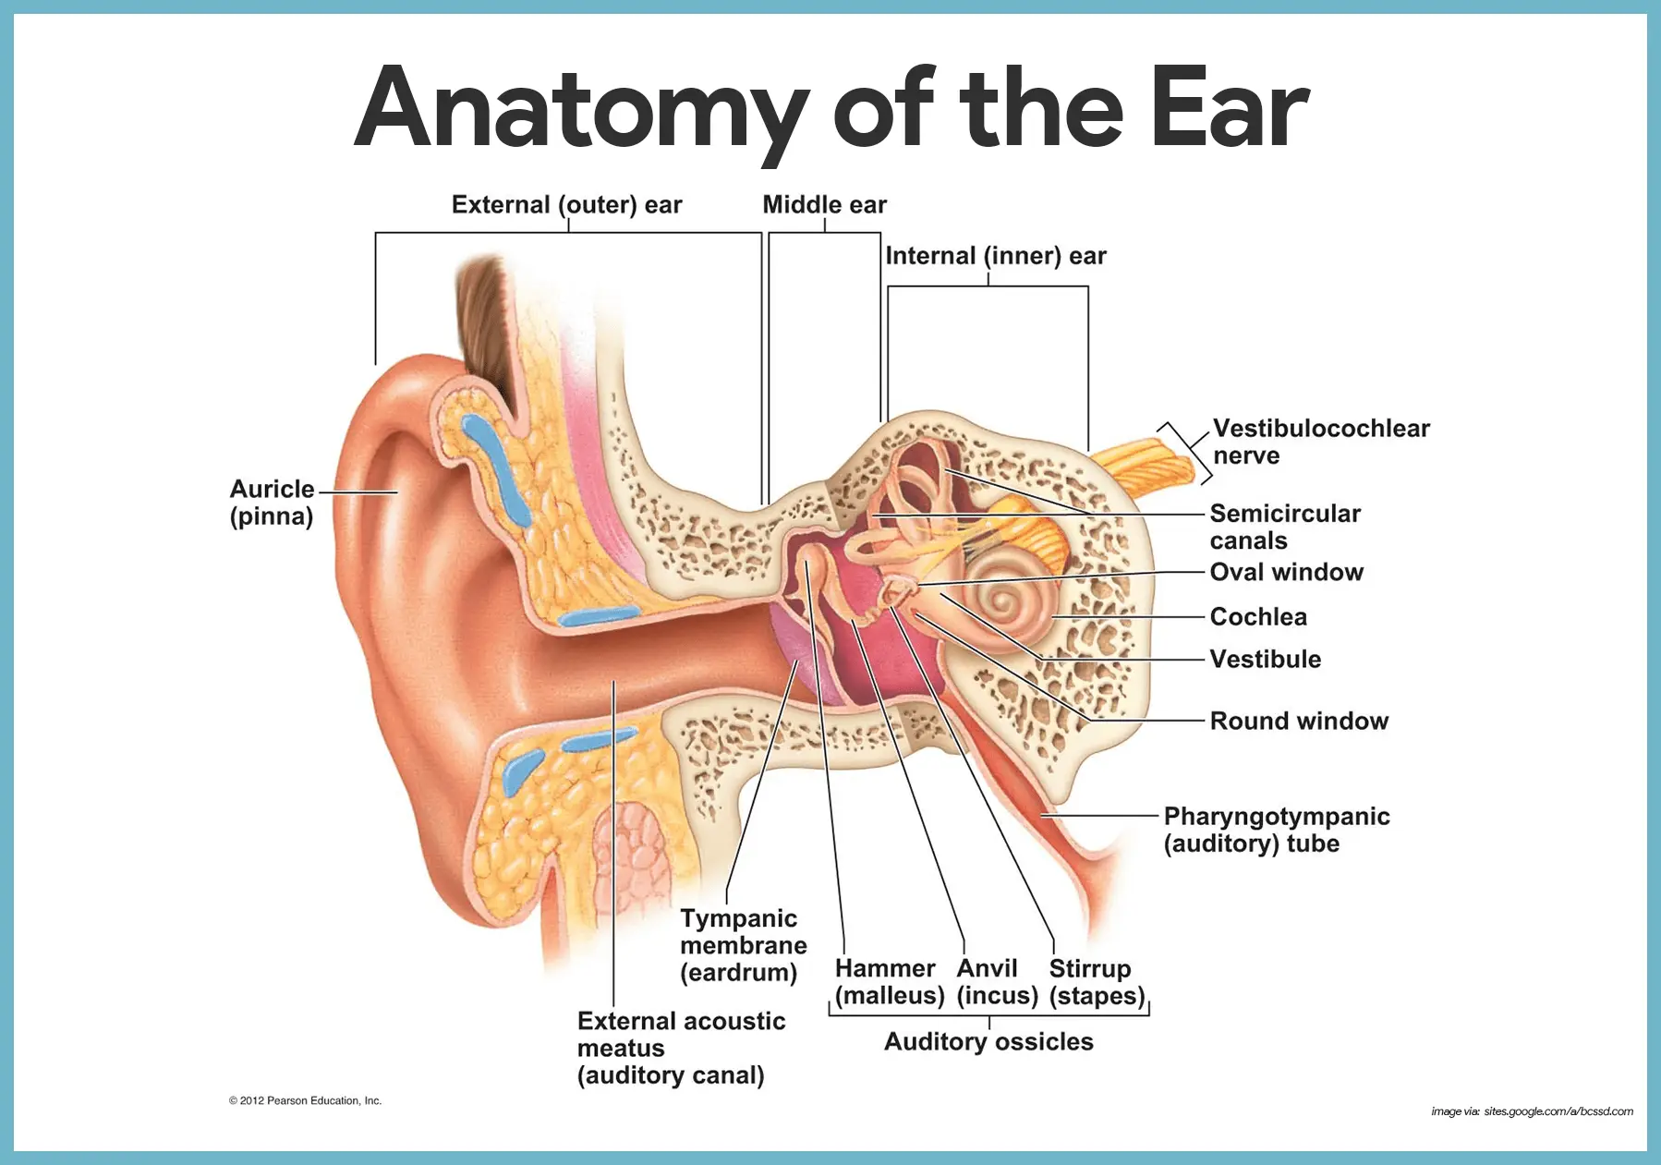

Slide 21
Hearing
The outer ear funnels the waves down the ear canal (the external acoustic meatus) to the tympanic membrane (the “ear drum”).
The sound waves beat against the tympanic membrane, creating mechanical vibrations in the membrane.
The tympanic membrane transfers these vibrations to three small bones, known as auditory ossicles, found in the air-filled cavity of the middle ear. These bones – the malleus, incus, and stapes – carry the vibrations and knock against the opening to the inner ear.
The inner ear consists of fluid-filled canals, including the spiral-shaped cochlea. As the ossicles pound away, specialized hair cells in the cochlea detect pressure waves in the fluid. They activate nervous receptors, sending signals through the cochlear nerve toward the brain, which interprets the signals as sounds.

Slide 22
External (Outer) Ear
The external, or outer, ear is composed of the auricle and the external acoustic meatus.
Auricle. The auricle, or pinna, is what most people call the “ear”- the shell-shaped structure surrounding the auditory canal opening.
External acoustic meatus. The external acoustic meatus is a short, narrow chamber carved into the temporal bone of the skull; in its skin-lined walls are the ceruminous glands, which secrete waxy, yellow cerumen or earwax, which provides a sticky trap for foreign bodies and repels insects.
Tympanic membrane. Sound waves entering the auditory canal eventually hit the tympanic membrane, or eardrum, and cause it to vibrate; the canal ends at the ear drum, which separates the external from the middle ear.

Slide 23
Middle ear
The middle ear, or tympanic cavity, is a small, air-filled, mucosa-lined cavity within the temporal bone.
Openings. The tympanic cavity is flanked laterally by the eardrum and medially by a bony wall with two openings, the oval window and the inferior, membrane-covered round window.
Pharyngotympanic tube. The pharyngotympanic tube runs obliquely downward to link the middle ear cavity with the throat, and the mucosae lining the two regions are continuous.
Ossicles. The tympanic cavity is spanned by the three smallest bones in the body, the ossicles, which transmit the vibratory motion of the eardrum to the fluids of the inner ear; these bones, named for their shape, are the hammer, or malleus, the anvil, or incus, and the stirrup, or stapes.

Slide 24
Internal (inner)ear
The internal ear is a maze of bony chambers, called the bony, or osseous, labyrinth, located deep within the temporal bone behind the eye socket.
Subdivisions. The three subdivisions of the bony labyrinth are the spiraling, pea-sized cochlea, the vestibule, and the semicircular canals.
Perilymph. The bony labyrinth is filled with a plasma-like fluid called perilymph.
Membranous labyrinth. Suspended in the perilymph is a membranous labyrinth, a system of membrane sacs that more or less follows the shape of the bony labyrinth.
Endolymph. The membranous labyrinth itself contains a thicker fluid called endolymph.

Slide 25
In the inner ear cochlea supports your hearing and your vestibule and semi-circular canals support your balance
Organ of corti is the structure in the cochlea of the inner ear which produces nerve impulses in response to sound vibrations.
It responds to vibration by initiating nerve impulses that are then perceived as hearing within the brain

Slide 26
Balance and the ear
The semi circular canals provide information about the position of the head in space, contributing to maintenance of posture and balance.
The arrangement of the three semicircular canals, one in each plane, not only allows perception of the position of the head in space but also the direction and rate of any movement.
Any change of position of the head causes movement in the perilymph and endolymph, which bends the hair cells and stimulates the sensory receptors.
Nerve impulses are transmitted by the vestibular nerve, which joins the cochlear nerve to form the vestibulocochlear nerve.
The cerebellum also receives nerve impulses from the eyes and proprioceptors (sensory receptors) in the skeletal muscles and joints.
The cerebellum coordinates incoming impulses from the vestibular nerve, the eyes and proprioceptors. Thereafter, impulses are transmitted to the cerebrum and skeletal muscles enabling perception of body position and any adjustments needed to maintain posture and balance.
This maintains upright posture and fixing of the eyes on the same point, independently of head movements.

Slide 27
Chemical senses: Taste and smell
The receptors for taste and olfaction are classified as chemoreceptors because they respond to chemicals in solution.
Olfactory Receptors
The sense of smell is called olfaction. It starts with specialized nerve receptors located on hairlike cilia in the epithelium at the top of the nasal cavity. When we sniff or inhale through the nose, some chemicals in the air bind to these receptors. That triggers a signal that travels up a nerve fiber, through the epithelium and the skull bone above, to the olfactory bulbs. The olfactory bulbs contain neuron cell bodies that transmit information along the cranial nerves, which are extensions of the olfactory bulbs. They send the signal down the olfactory nerves, toward the olfactory area of the cerebral cortex.

Slide 28
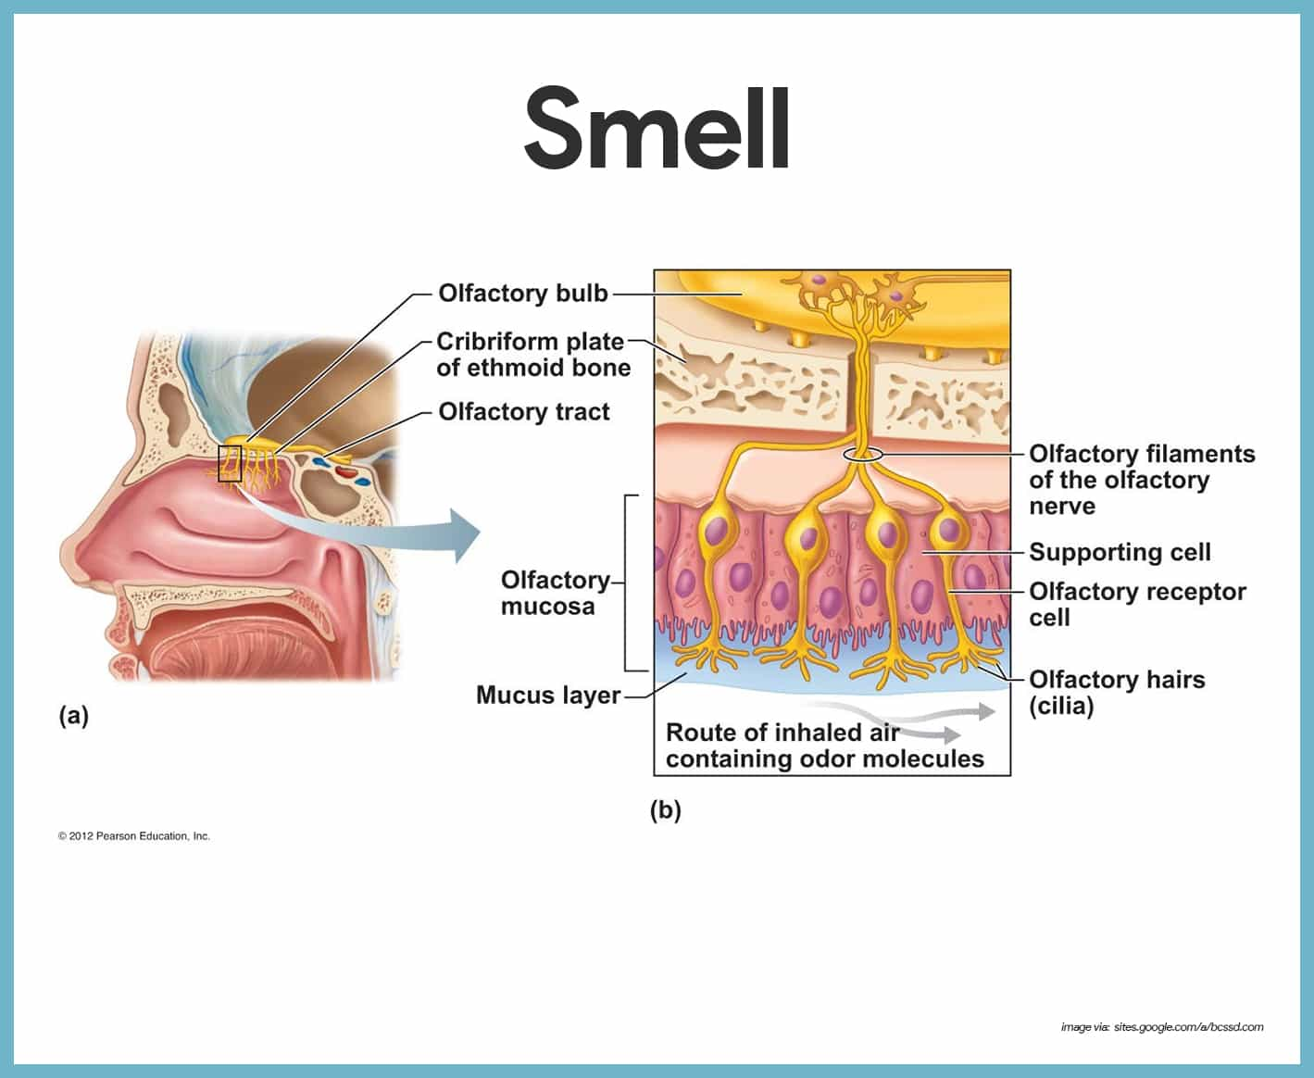

Slide 29
Olfactory receptor cells. The olfactory receptor cells are neurons equipped with olfactory hairs, long cilia that protrude from the nasal epithelium and are continuously bathed by a layer of mucus secreted by underlying glands.
Olfactory filaments. When the olfactory receptors located on the cilia are stimulated by chemicals dissolved in the mucus, they transmit impulses along the olfactory filaments, which are bundled axons of olfactory neurons that collectively make up the olfactory nerve.
Olfactory nerve. The olfactory nerve conducts the impulses to the olfactory cortex of the brain.

Slide 30
Taste buds and sense of taste
The small bumps on the top of the tongue are called papillae. Many of them, including circumvallate papillae and fungiform papillae, contain taste buds. When we eat, chemicals from food enter the papillae and reach the taste buds. These chemicals (or tastants) stimulate specialized gustatory cells inside the taste buds, activating nervous receptors. The receptors send signals to fibers of the facial, glossopharyngeal, and vagus nerves. Those nerves carry the signals to the medulla oblongata, which relays them to the thalamus and cerebral cortex of the brain.

Slide 31
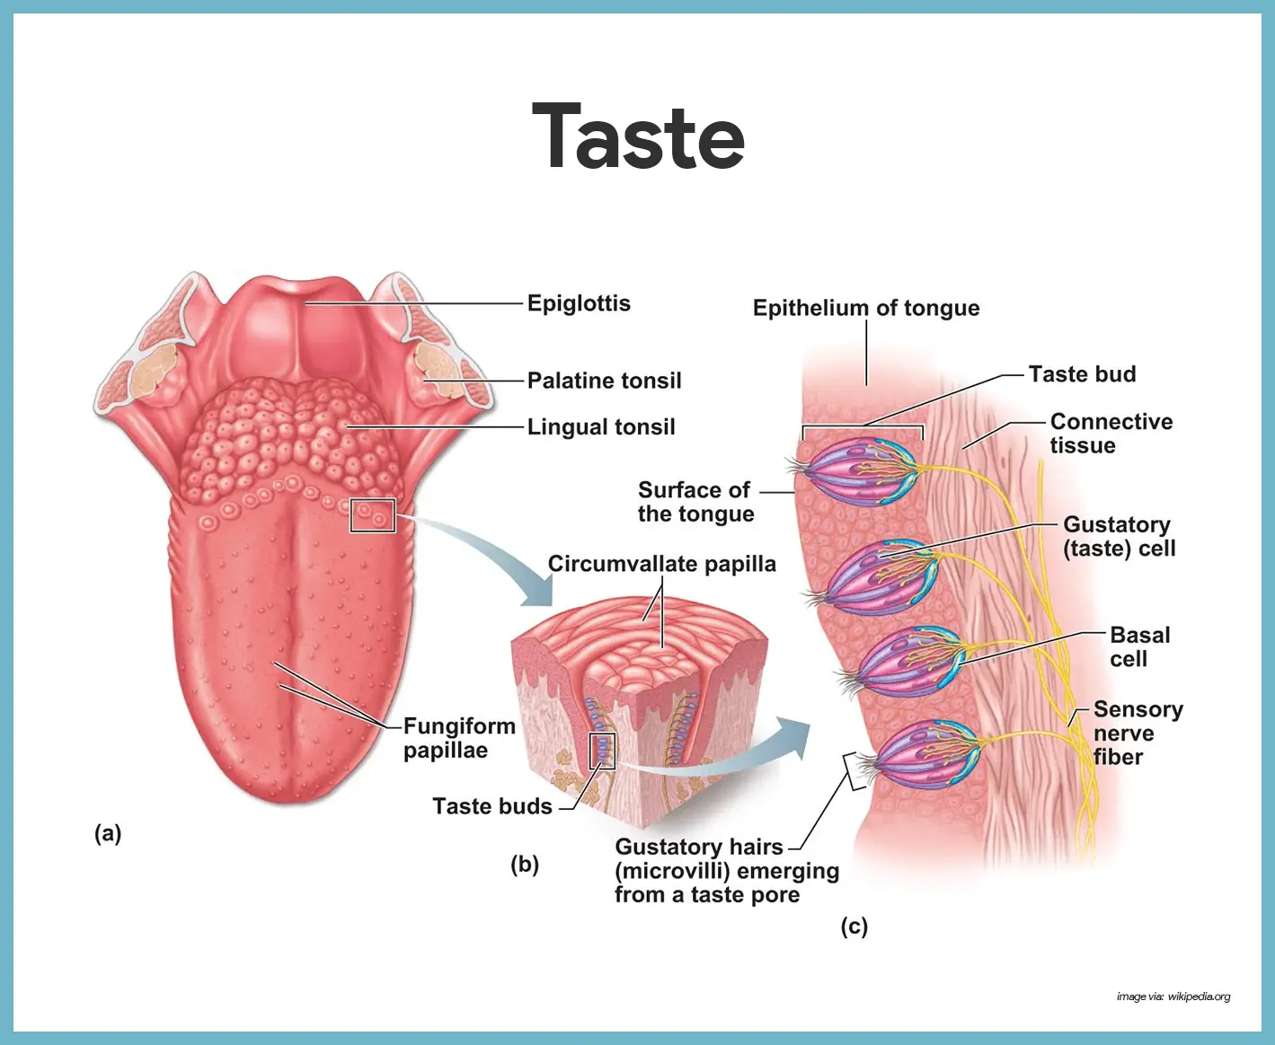

Slide 32
Taste buds. The taste buds, or specific receptors for the sense of taste, are widely scattered in the oral cavity; of the 10, 000 or so taste buds we have, most are on the tongue.
Papillae. The dorsal tongue surface is covered with small peg-like projections, or papillae.
Circumvallate and fungiform papillae. The taste buds are found on the sides of the large round circumvallate papillae and on the tops of the more numerous fungiform papillae.
Gustatory cells. The specific cells that respond to chemicals dissolved in the saliva are epithelial cells called gustatory cells.
Gustatory hairs. Their long microvilli- the gustatory hairs- protrude through the taste pore, and when they are stimulated, they depolarize and impulses are transmitted to the brain.
Facial nerve. The facial nerve (VII) serves the anterior part of the tongue.
Glossopharyngeal and vagus nerves. The other two cranial nerves- the glossopharyngeal and vagus- serve the other taste bud-containing areas.
Basal cells. Taste bud cells are among the most dynamic cells in the body, and they are replaced every seven to ten days by basal cells found in the deeper regions of the taste buds.

